Slide 1
J P A
Authored by : Sangeeta Joshi Presented by: Sangeeta Joshi

Slide 2
Agenda
JPA Introduction
Persistence Context
Entity Manager
Entities
Inheritance

Slide 3
Java Persistence API (JPA) Architecture
Data persistence, the ability to maintain data between application executions, is vital to enterprise applications.
Applications that are developed for this environment must manage persistence themselves or make use of third-party solutions to handle database updates and retrievals with persistence.
The Java Persistence API (JPA) provides a mechanism for managing persistence and object-relational mapping and functions for the EJB 3.0 specifications.

Slide 4
Java Persistence API : It is a Specification
JPA represents a simplification of the persistence programming model.
The JPA specification explicitly defines the object-relational mapping, rather than relying on vendor-specific mapping implementations.
JPA standardizes the important task of object-relational mapping by using annotations or XML to map objects into one or more tables of a database.

Slide 5
Introduction to the Java Persistence API
The Java Persistence API provides an object/relational mapping facility for
managing relational data in Java applications.
Java Persistence consists of four areas:
- The Java Persistence API
- The query language
- The Java Persistence Criteria API
- Object/relational mapping metadata

Slide 6
JPA
Understanding Java persistence
Persistence refers to the ability to store objects in a database and use those objects with transactional integrity.
In a J2EE application, data is typically stored and persisted in
the data tier, in a relational database.
Entity beans are enterprise beans that contain persistent data and that can be saved in various persistent data stores. The entity beans represent data from a database.
Each entity bean carries its own identity. Entity beans can be deployed using application-managed persistence or container-managed persistence.

Slide 7
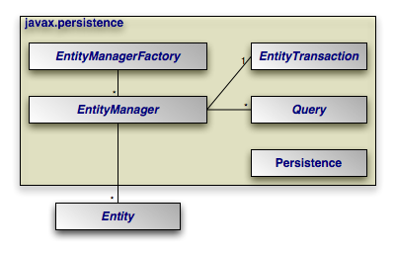
Java Persistence API (JPA) Architecture

Slide 8
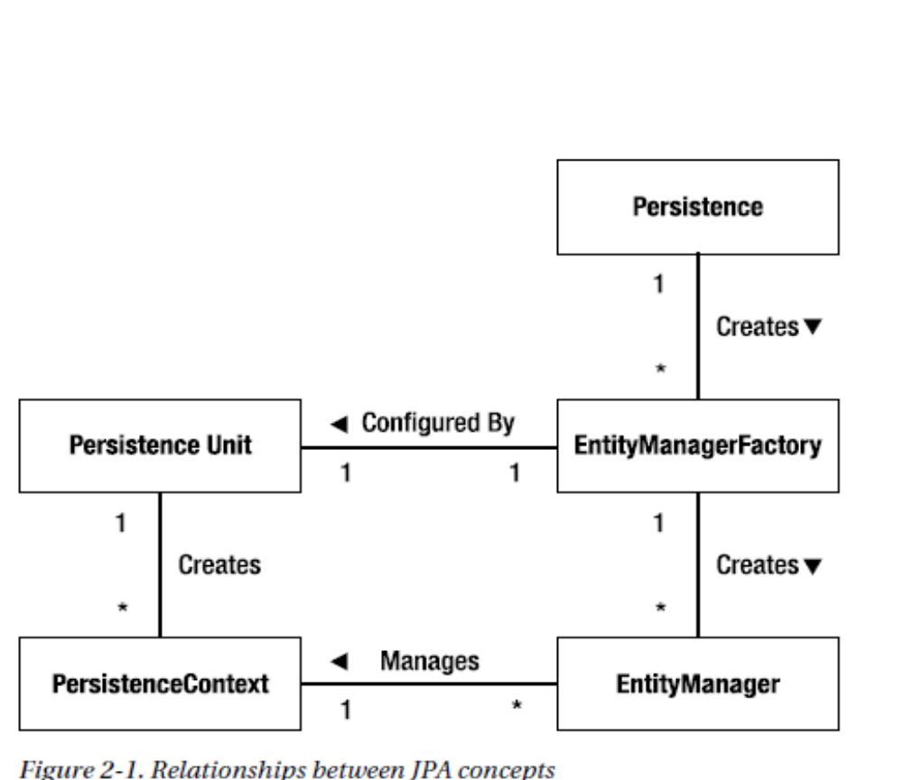
Java Persistence API (JPA) Architecture

Slide 9
Elements of a JPA Persistence Provider
A JPA persistence provider uses the following elements to allow for easier persistence management.
Persistence unit: consists of the declarative meta-data that describes the relationship of entity class objects to a relational database.
EntityManagerFactory: used to create an Entity Manager for database interactions.
EntityManager: the resource manager that maintains the active collection of entity objects that are being used by the application.
The EntityManager handles the database interaction and meta-data for
object-relational mappings.
Persistence context: defines the set of active instances that the application is manipulating currently. The persistence context can be created manually or through injection.

Slide 10
Elements of a JPA Persistence Provider
Entity : Entites are persistent objects that represent datastore records.
Entity Transaction: Each EntityManager has a one-to-one relation with a single javax.persistence.EntityTransaction. EntityTransactions allow operations on persistent data to be grouped into units of work that either completely succeed or completely fail, leaving the datastore in its original state. These all-or-nothing operations are important for maintaining data integrity.
Query : The javax.persistence.Query interface is implemented by each JPA vendor to find persistent objects that meet certain criteria. JPA standardizes support for queries using both the Java Persistence Query Language (JPQL) and the Structured Query Language (SQL). You obtain Query instances from an EntityManager.

Slide 11
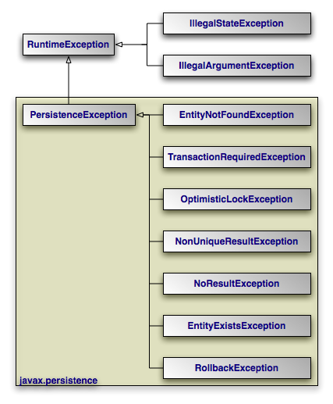
Elements of a JPA Persistence Provider
JPA Exceptions

Slide 12
JPA : Entities
An entity is a lightweight persistence domain object.
Typically, an entity represents a table in a relational database, and each entity instance corresponds to a row in that table.
The primary programming artifact of an entity is the entity class, although entities can use helper classes.
The persistent state of an entity is represented through either persistent fields or persistent properties.
These fields or properties use object/relational mapping annotations to map the entities and entity relationships to the relational data in the underlying data store.

Slide 13
JPA : Entities
Requirements for Entity Classes
The class must be annotated with the javax.persistence.Entity annotation.
The class must have a public or protected, no-argument constructor. The class may have other constructors.
The class must not be declared final. No methods or persistent instance variables must be declared final.
If an entity instance is passed by value as a detached object, such as through a session bean’s remote business interface, the class must implement the Serializable interface.
Entities may extend both entity and non-entity classes, and non-entity classes may extend entity classes.
Persistent instance variables must be declared private, protected, or package-private and can be accessed directly only by the entity class’s methods. Clients must access the entity’s state through accessor or business methods.

Slide 14
JPA : Entity states
new, or transient - the entity has just been instantiated and is not associated with a persistence context. It has no persistent representation in the database and no identifier value has been assigned.
managed, or persistent - the entity has an associated identifier and is associated with a persistence context.
detached - the entity has an associated identifier, but is no longer associated with a persistence context (usually because the persistence context was closed or the instance was evicted from the context)
removed - the entity has an associated identifier and is associated with a persistence context, however it is scheduled for removal from the database.

Slide 15
JPA :Primary Keys in Entities
Each entity has a unique object identifier.
The unique identifier, or primary key, enables clients to locate a particular entity instance.
Every entity must have a primary key.
An entity may have either a simple or a composite primary key.
Simple primary keys use the javax.persistence.Id annotation to denote the primary key property or field.
Composite primary keys are used when a primary key consists of more than one attribute, which corresponds to a set of single persistent properties or fields.
Composite primary keys must be defined in a primary key class.
Composite primary keys are denoted using the javax.persistence.EmbeddedId and javax.persistence.IdClass annotations.

Slide 16
JPA
The primary key, or the property or field of a composite primary key, must be one of the following Java language types:
Java primitive types
Java primitive wrapper types
java.lang.String
java.util.Date
java.math.BigDecimal
java.math.BigInteger
Floating-point types should never be used in primary keys. If you use a generated primary key, only integral types will be portable.
.

Slide 17
JPA
A primary key class must meet these requirements:
The access control modifier of the class must be public.
The properties of the primary key class must be public or protected if property-based access is used.
The class must have a public default constructor.
The class must implement the hashCode() and equals(Object other) methods.
The class must be serializable.

Slide 18
JPA :interface EntityManager
Interface used to interact with the persistence context.
An EntityManager instance is associated with a persistence context.
A persistence context is a set of entity instances in which for any persistent entity identity there is a unique entity instance.
Within the persistence context, the entity instances and their lifecycle are managed.
The EntityManager API is used to create and remove persistent entity instances, to find entities by their primary key, and to query over entities.
The set of entities that can be managed by a given EntityManager instance is defined by a persistence unit. A persistence unit defines the set of all classes that are related or grouped by the application, and which must be collocated in their mapping to a single database.

Slide 19
JPA

Slide 20
Any Questions?

